Slide 1
Fast Food Craveability
How Restaurants Exploit our Neurological Vulnerability

Slide 2
Definitions……
Vulnerability refers to a person's state of being liable to succumb to manipulation, persuasion, temptation etc.
To exploit means to take advantage of a person or situation unethically or unjustly for one’s own ends.
An addiction is the state of being enslaved to a habit, or to practice something that is psychologically or physically habit forming to such an extent that it’s cessation causes harm.
A habit is an acquired behavior pattern regularly followed until it has become almost involuntary.

Slide 3
How do we become addicted to fast food?
Fast food contains large amounts of fat.
Human beings have a neurological vulnerability to fat.
Lepton Hormone
The more fat we consume, the more fat our body needs
Regular fast food eaters who try to eat healthy will begin to go into starvation mode because there Lepton threshold is not being met.

Slide 4
Leptin

Slide 6
Fat Levels in Fast Food

Slide 7
Restaurants Layering Fat into our meals to create craveability
A quarter pound cheeseburger made at home has bout 12 grams of fat.
A quarter pound cheeseburger at a Fast-food Restaurant has an Average of 32 grams of fat.
A grilled chicken sandwich made at home has about 6.4 grams of fat.
A grilled chicken sandwich at a Fast-food restaurant has an average of 21 grams of fat.

Slide 8
McDonalds Fattiest Hamburger Yet!
Angus Deluxe Contains 44 grams of fat
Quarter Pounder with cheese contains 26 grams of fat.

Slide 9
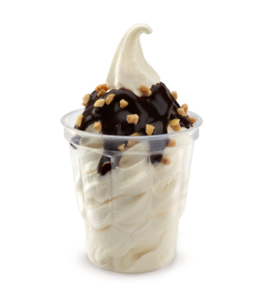
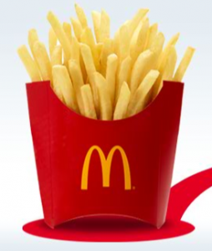
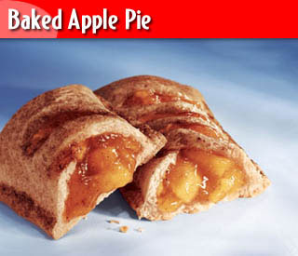
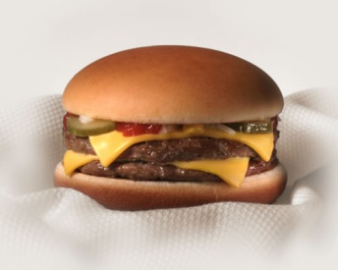
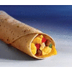
Getting more people hooked with lower prices
McDonalds introduced their dollar menu in 2002
Drawing in large amounts of people with their low prices
Offered customers low prices on foods that are potentially addictive if consumed regularly.
25g/fat
20g/fat
12g/fat
26g/fat
36g/fat

Slide 10
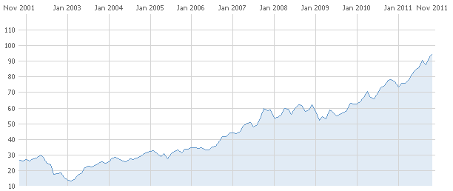
McDonalds Dollar Menu Attracting new Patrons
Fast Food Restaurants lose money on their dollar menus in the short term, but in the long run it all pays off.
Dollar Menu Begins 2002
Moneycentral.com

Slide 11
Effects of the Fast-food industry in America
Between 1980 and 2010 obesity rates have doubled among adults.
1 in 3 adults are obese
They have tripled among adolescence
1 in 4 children are obese
Behaviors causing the obesity epidemic are well known and preventable; unhealthy diet, physical inactivity.
Despite our knowledge and awareness the rates continue to climb.

Slide 12
Obesity Epidemic

Slide 13
Obesity by State VS. Fast Food restaurant locations.

Slide 14
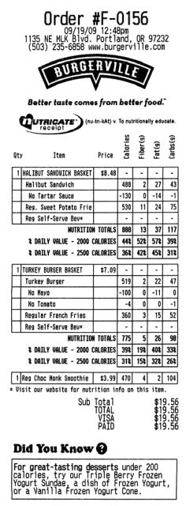
What has been done legally to prevent this from getting worse?
In 2009 California passed a law that made fast food restaurants put nutritional information right on the menu.
In 2010 California banned toys from being distributed in children's happy meals that contained high amounts of calories and fat.

Slide 15
What can we do to prevent fast food chains from exploiting our vulnerability to fatty foods?
Creating a law to tell people to stop eating fast food is not the answer.
Quietly Intervening on the composition of food by reducing fat, sodium content, and portion sizes seems to be the right choice.

Slide 16
Education in Key
We must find subtle ways to educate ourselves and our children about what we were putting into our bodies.
The more we know about nutrition and how the nutrients we consume are processed in our bodies, the better chance we have at not succumbing to unhealthy eating addictions.
The End

